Slide 1

Machine Learning: Communicating Machine Learning Results
Notes:
TYLER:
INTRO TO COURSE AND INSTRUCTORS
PARTICIPANT SURVEY

Slide 2

Agenda
Identify & Analyze Audience
Common Mistakes
Best Practices
Case Study
Effective Data Visualizations
Additional Resources
Question & Answer
Notes:
TYLER:
THE AGENDA FOR TODAY’S COURSE IS AS FOLLOWS…
IF YOU HAVE ANY QUESTIONS THROUGHOUT THE PRESENTATION, PLEASE SAVE THEM UNTIL THE END WHERE WE WILL PROVIDE 5-10 MINUTES FOR Q&A.

Slide 3
Identify & Analyze Audience
Notes:
TYLER:
EXTREMELY IMPORTANT STEP
SHAPES THE ENTIRE STRUCTURE OF YOUR DELIVERABLE
CAN BE ACCOMPLISHED THROUGH CLIENT ENGAGEMENT

Slide 4
Questions to Ask About Audience
Before presenting your results, you must identify and evaluate your audience and their familiarity with the techniques used to solve their business problem.
Who is your audience?
By identifying your audience, you can tailor your results to best fit their perspective, interests, and technical expertise.
03
How much detail do they want?
Based on their level of expertise, alter your visuals, language, and recommendations to effectively communicate your results.
01
02
What does your audience care about?
Ask what the business impact is that your audience would like to see as a result of the model created.
04
How familiar are they with machine learning techniques?
Their level of expertise can determine how much detail to provide about the processes used to achieve the results.
Notes:
TYLER:
THE FIRST STEP TO COMMUNICATING MACHINE LEARNING RESULTS IS TO EFFECTIVELY IDENTIFY WHO YOUR AUDIENCE IS
BY ANALYZING YOUR AUDIENCE AND THEIR TECHNICAL BACKGROUND YOU CAN BETTER DELIVER THE RESULTS FROM YOUR MACHINE LEARNING MODEL.
ALTER PRESENTATION BASED ON AUDIENCE/EXPERTISE
DIVE INTO EACH QUESTION WITH HYPOTHETICALS (AUDIENCE ENGAGMENT)

Slide 5
Common Mistakes
Notes:
TYLER:
NOW I WILL TOUCH ON A FEW COMMON MISTAKES MADE WHEN COMMUNICATING MACHINE LEARNING RESULTS AFTER YOU HAVE IDENTIFIED AND ANALYZED THE CHARACTERISTICS OF YOUR AUDIENCE.

Slide 6
Common Mistakes
When communicating the results of your machine learning technique it is important to avoid a few things that take away from delivering a clear and concise message.
  Visuals Without Explanation
  Omitting Key Details
  Under/Over Explaining
  Avoiding Audience Feedback
  Selecting the Wrong Visuals
Preforming a cluster
analysis without providing
a label/key for each cluster.
Failing to state the impact your model will have on
the current business
process.
Incorrectly identifying the
amount of detail your
audience wants to receive.
Not providing your audience
time to ask questions about
the process used to reach
a final solution.
Choosing a bar chart instead of a line graph to explain time-series data or trends over a period.
Notes:
TYLER:
WHEN COMMUNICATING YOUR RESULTS IT IS IMPORTANT TO AVOID MAKING THESE COMMON MISTKES
PROVIDING VISUALS WITHOUT EXPLANATION (VISUALS CAN BE EXTREMELY BENEFICIAL WHEN USED CORRECTLY)
OMITTING KEY DETAILS (FOR EXAMPLE)
UNDER/OVER EXPLAINING (ALTER THE AMOUNT OF DETAIL AND GRANUALRITY YOU WILL PRESENT BASED ON YOUR AUDIENCE’S FAMIARITY WITH THE METHODS USED)
AVOIDING AUDIENCE FEEDBACK (AUDIENCE FEEDBACK CAN HELP IMPROVE FUTURE MODELS AND PROVIDE A DIFFERENT PERSPECTIVE)
SELECTING THE WRONG VISUALS (USE THE APPROPRIATE CHART/GRAPH FOR THE DATA TYPE BEING USED)

Slide 7
Best Practices
Notes:
TYLER:
NOW THAT WE HAVE IDENTIFIED COMMON MISTAKES, WE WILL DIVE INTO THE BEST PRACTICES TO IMPLEMENT WHEN COMMUNICATING MACHIEN LEARNING RESULTS.

Slide 8
Best Practices
Make the audience aware of the business problem to illustrate the effectiveness of the suggested solution.
Create a compelling story that helps your audience understand complex insights and apply them to the business problem.
How to create a story?
Situation
Problem
Solution
Next steps
Briefly Explain Business Problem
Create a Story
What are the key insights?
What does the audience care about?
What impact does the model make?
Highlight Results
In order to effectively communicate your results, you must:
Avoid Technical Jargon
Leverage Effective Models
Keep It Simple
For non-technical audiences simplify verbiage to explain machine learning process used.
Determine the best models to provide actionable insights to the audience.
Notes:
TYLER:
TOUCH ON A FEW OF THE BEST PRACTICES
FOCUS MOST ON STORYTELLING AND AVOIDING TECHNICAL JARGON
PASS TO MUHAMMAD FOR CASE STUDY

Slide 9
Case Study

Slide 10
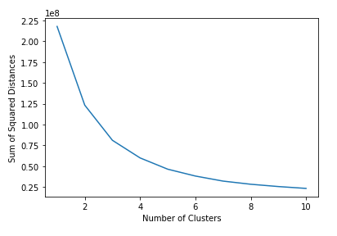
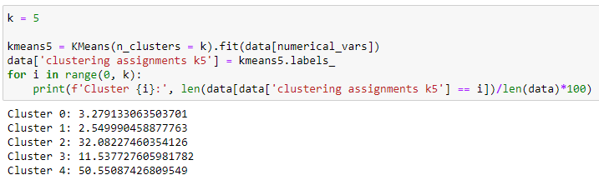
Segmentation Analysis Case Study
Walkthrough of a common segmentation problem and how the results will be relayed to different types of audiences.
Elbow Plot:
Introducing the Problem:
Your team is supporting a client to prepare for upcoming housing listings. Your client is heavily involved with real estate investing and converts their properties into Airbnbs after acquiring and renovating them. The client is interested in classifying potential new listings with similar listings they already have.
Defining the Approach:
“similar listings” = grouping client’s existing listings based on different attributes
dataset of Airbnb listings and their attributes
Unsupervised ML model (K-Means Clustering)
Results:
Optimal number of clusters k = 5
2 larger clusters, 2 smaller clusters, 1 mid sized cluster
Attributes used for segmentation: 'accommodates', 'bathrooms’, 'bedrooms’, 'beds’, 'cleaning_fee’, 'host_has_profile_pic’, 'host_identity_verified’, 'host_response_rate’, 'instant_bookable’, 'latitude’, 'longitude’, 'number_of_reviews’, 'review_scores_rating'
Notes:
Give quick overview of K-Means when talking about the approach

Slide 11
Communicating to Different types of Audiences
There are many elements that you should consider when conducting an Audience Analysis. Here we will focus on one example where we communicate the results through 2 different lenses.
Example Audience Analysis: Differences between Technical and Non-Technical Stakeholders
Technical Stakeholders
Non-Technical Stakeholders
Focus areas:
Technical Process – Unsupervised Learning in Python
Relevant metrics – Sum of Squared Differences
Optimal Number of Clusters – K = 5
How the trained model can be productionalized
Relevant Visualizations:
Elbow Plot
Distribution of clusters across Airbnb listings
Focus areas:
Targeted approach to acquiring new properties –
  Relay how the model can identify properties that fall into our smaller clusters so that we can have a more even real estate investment portfolio
  Identify differences in profits across segments and acquire listings that will fall into segments that generate higher profits
Shifting approach to focus on certain states or locations based on segments that the client does not have enough Airbnbs
Relevant Visualizations/Demos:
Given a new listing, show which segment it would fall under
Differences in profit across listing segments
Notes:
Highlighting two extremes but ideally audience will be a mix of both

Slide 12
Effective Data Visualization

Slide 13
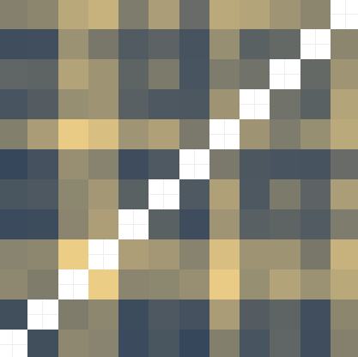
Common Visualization Types
Table of visualization for different types of analyses
Visualization Type | Best Uses | Examples | Visuals
Bar Graphs/Histograms | Show numbers in different groupings or categories Numerical data for different categories | The number of COVID cases by state
Line Graphs | Show how data changes over time Numerical data Time-series data | The number of COVID cases for Arlington, VA for the past 12 months
Scatter Plots | Show associations between two variables Numerical data | X and Y relationships between two variables: average income for adults compared with their years of education
Heat Maps | Shows the relationships between variables Numerical data | A correlation matrix showing the correlation between all variables in a dataset: how much ice cream a person eats correlated with how many times they visit the dentist in a year
Pie Charts | Show how a whole is divided up into different parts Non-negative numerical data adding up to a "whole" (ex. Percentages of a whole) | Assume you're a company that sells 5 products. You could visualize your percentage of total sales by each specific product

Slide 14
Additional Resources

Slide 15
Deliver a great presentation (linkedin.com)
A Data Scientist's Guide to Communicating Results - insideBIGDATA
How to Communicate Clearly About Machine Learning. | by Daniel Rothmann | Towards Data Science
Storytelling With Data: A Data Visualization Guide for Business Professionals
Book - Cole Nussbaumer Knaflic
How to Present Machine Learning Results to Non-Technical People
Visualizations That Really Work

Slide 16
Questions

